Slide 1
Perfect Square Trinomials
(a + b)² = a² + 2ab + b² (a - b)² = a² – 2ab + b²

Slide 2
Review: Multiply (y + 2)² (y + 2)(y + 2)
Do you remember these?
(a + b)² = a² + 2ab + b² (a - b)² = a² – 2ab + b²
y²
First terms:
Outer terms:
Inner terms:
Last terms:
Combine like terms.
y² + 4y + 4
Using the formula,
(y + 2)² = (y)² + 2(y)(2) + (2)²
(y + 2)² = y² + 4y + 4
Which one is quicker?
+2y
+2y
+4

Slide 3
1) Factor x² + 6x + 9
Does this fit the form of our perfect square trinomial?
Is the first term a perfect square?
Yes, a = x
2) Is the last term a perfect square?
Yes, b = 3
Is the middle term twice the product of the a and b?
Yes, 2ab = 2(x)(3) = 6x
Perfect Square Trinomials
(a + b)² = a² + 2ab + b² (a - b)² = a² – 2ab + b²
Since all three are true, write your answer!
(x + 3)²
You can still factor the other way but this is quicker!

Slide 4
2) Factor y² – 16y + 64
Does this fit the form of our perfect square trinomial?
Is the first term a perfect square?
Yes, a = y
2) Is the last term a perfect square?
Yes, b = 8
Is the middle term twice the product of the a and b?
Yes, 2ab = 2(y)(8) = 16y
Perfect Square Trinomials
(a + b)² = a² + 2ab + b² (a - b)² = a² – 2ab + b²
Since all three are true, write your answer!
(y – 8)²

Slide 5
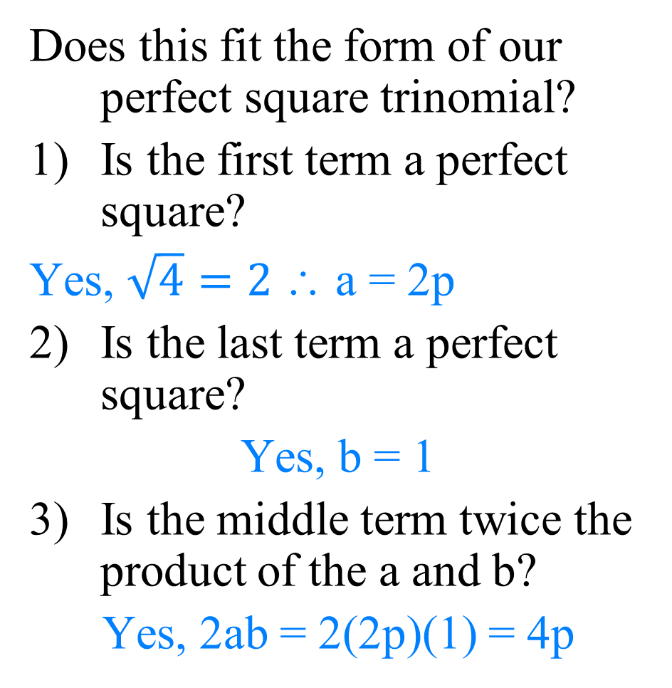
3) Factor 4p² + 4p + 1
Does this fit the form of our perfect square trinomial?
Is the first term a perfect square?
Yes, $\sqrt{4}=2$∴ a = 2p
2) Is the last term a perfect square?
Yes, b = 1
Is the middle term twice the product of the a and b?
Yes, 2ab = 2(2p)(1) = 4p
Perfect Square Trinomials
(a + b)² = a² + 2ab + b² (a - b)² = a² – 2ab + b²
Since all three are true, write your answer!
(2p + 1)²

Slide 6
4) Factor 25x² – 110xy + 121y²
Does this fit the form of our perfect square trinomial?
Is the first term a perfect square?
Yes, a = 5x
Is the last term a perfect square?
Yes, b = 11y
Is the middle term twice the product of the a and b?
Yes, 2ab = 2(5x)(11y) = 110xy
Perfect Square Trinomials
(a + b)² = a² + 2ab + b² (a - b)² = a² – 2ab + b²
Since all three are true, write your answer!
(5x – 11y)²

Slide 7
Factor 9k² + 12k + 4
(3k + 2)²
(3k – 2)²
(3k + 2)(3k – 2)
I’ve got no clue…I’m lost!

Slide 8
Factor 2r² + 12r + 18
prime
2(r² + 6r + 9)
2(r – 3)²
2(r + 3)²
2(r – 3)(r + 3)
Don’t forget to factor the GCF first!

